Slide 1
Real-Time Location Recommendation System for Field Data Collection
Aris Prawisudatama

Slide 2
Background
Start at the same time
Estimated Transport Time
Estimated Enumeration TIme
Finish almost at the same time

Slide 3
Background
Similar With
Multi Depot Vehicle Routing Problem
2
1
10
3
11
A
9
B
7
4
5
8
12
6

Slide 4
Background
Enumeration Time Cannot Be Estimated
Available After Visited
Number of Individu
Non Technical Reasons
Enumerator Capability
Respondent Understanding

Slide 5
Background
Solusion
Use Markov Process
+
Unequal Time of Completion
Communication Mechanism
Publish / Subscribe

Slide 6
Design Overview
Publisher
Thread Pool
Message Broker
Enumerator 1:
Depot = L2
Thread 1:
VRP Solver 1
Topic 1:
Location L1
Enumerator 2:
Depot = L1
Thread 2:
VRP Solver 2
Topic 2:
Location L2
.
.
.
.
.
.
.
.
.
Thread n:
VRP Solver n
Topic n:
Location Ln
Enumerator e:
Depot = Ln

Slide 7
Topic Watcher
Start
Periodically check the available subscribed topics in message broker
A Thread will be created for every new topic available
The thread will be completed with VRP Solver procedure
Every thread will be append to a Thread Pool
Read Available Topics in Broker
Delay 5 Seconds
m = 1
C = Topic Count
m <= C
Create Thread
Append to ThreadPool
m = m + 1

Slide 8
Recommendation Publisher
Publisher
Thread is run consecutively
One thread per session
Includes all enumerators and all unallocated locations
Thread Pool
Thread 1:
VRP Solver 1
7
2
Thread 2:
VRP Solver 2
4
B
.
.
.
5
6
A
8
3
Thread n:
VRP Solver n
1

Slide 9
VRP Solver Using Cooperative Coevolution Algorithms (CoEAs)
Complex Decomposable Problem
Divide Problem
Subproblem 1
population
Subproblem 2
population
Subproblem 3
population
*
*
*
Make Complete Solution
*
Feedback
Fitness Function Configuration

Slide 10
Message Broker Multi-Broker Architecture
X1
X8
X2
X7
B1
B5
X3
B3
B4
B2
X4
X6
X5

Slide 11
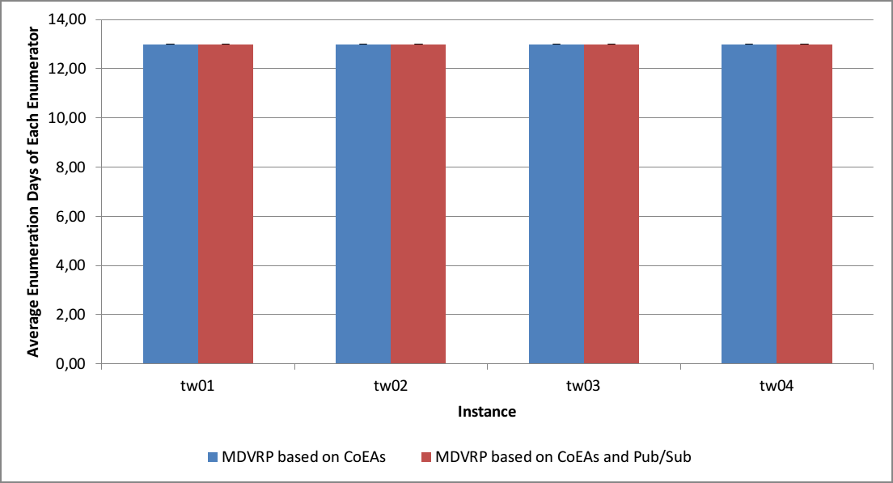

Slide 12
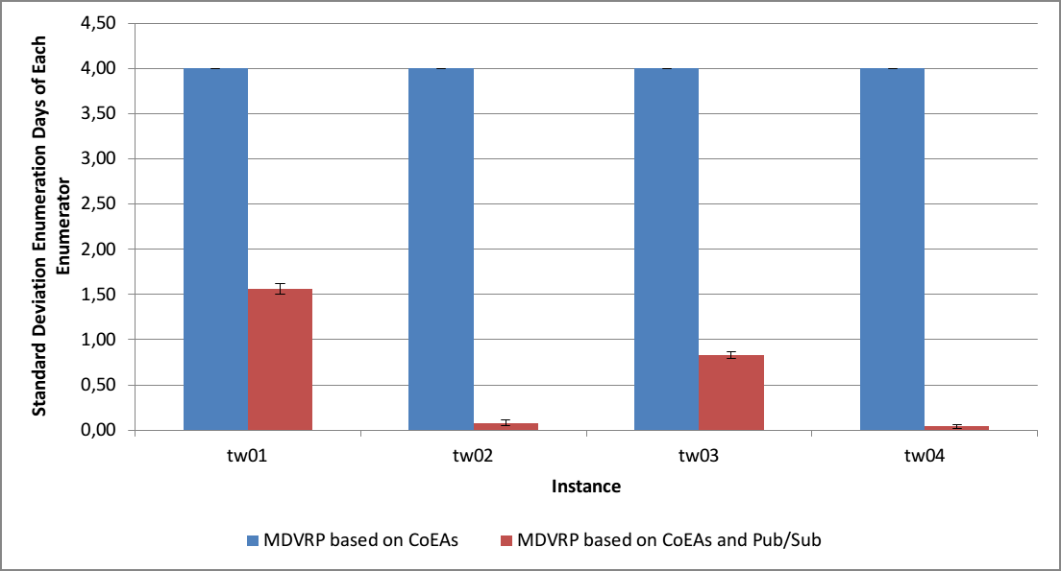

Slide 13
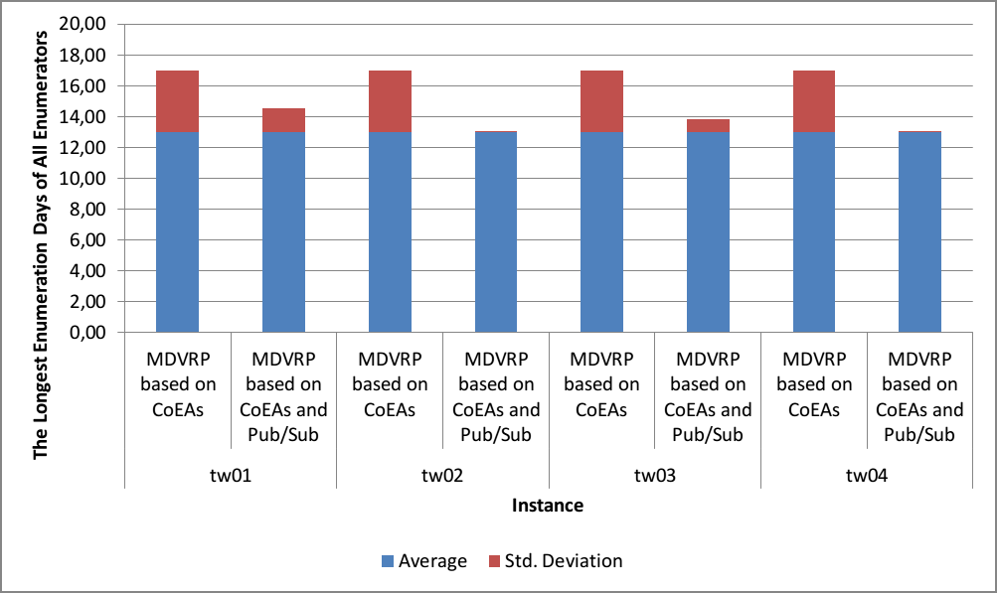

Slide 14
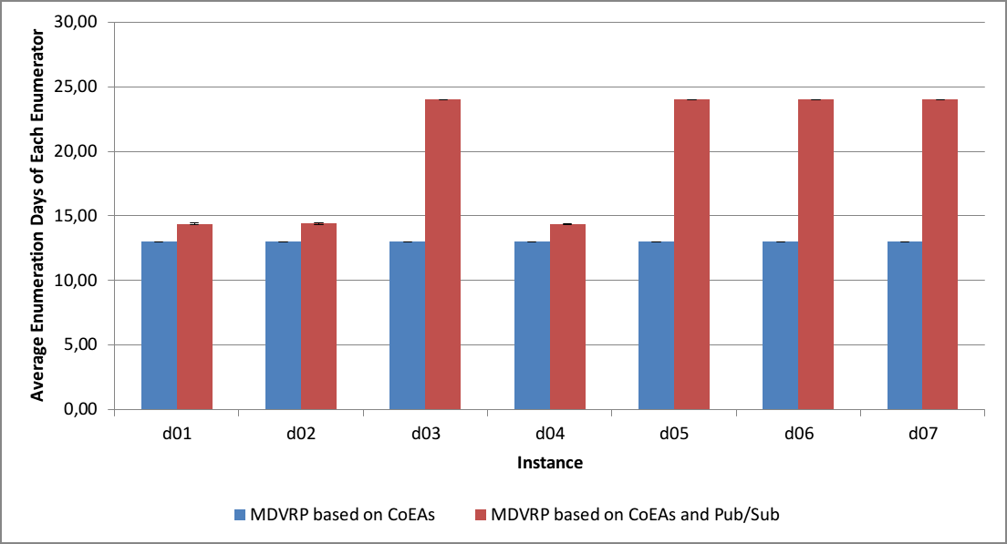

Slide 15
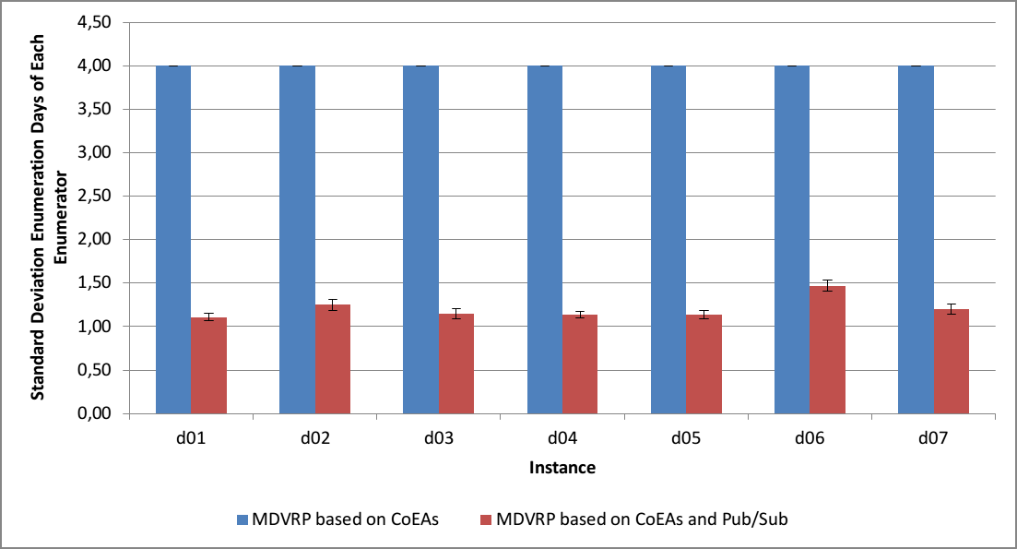

Slide 16
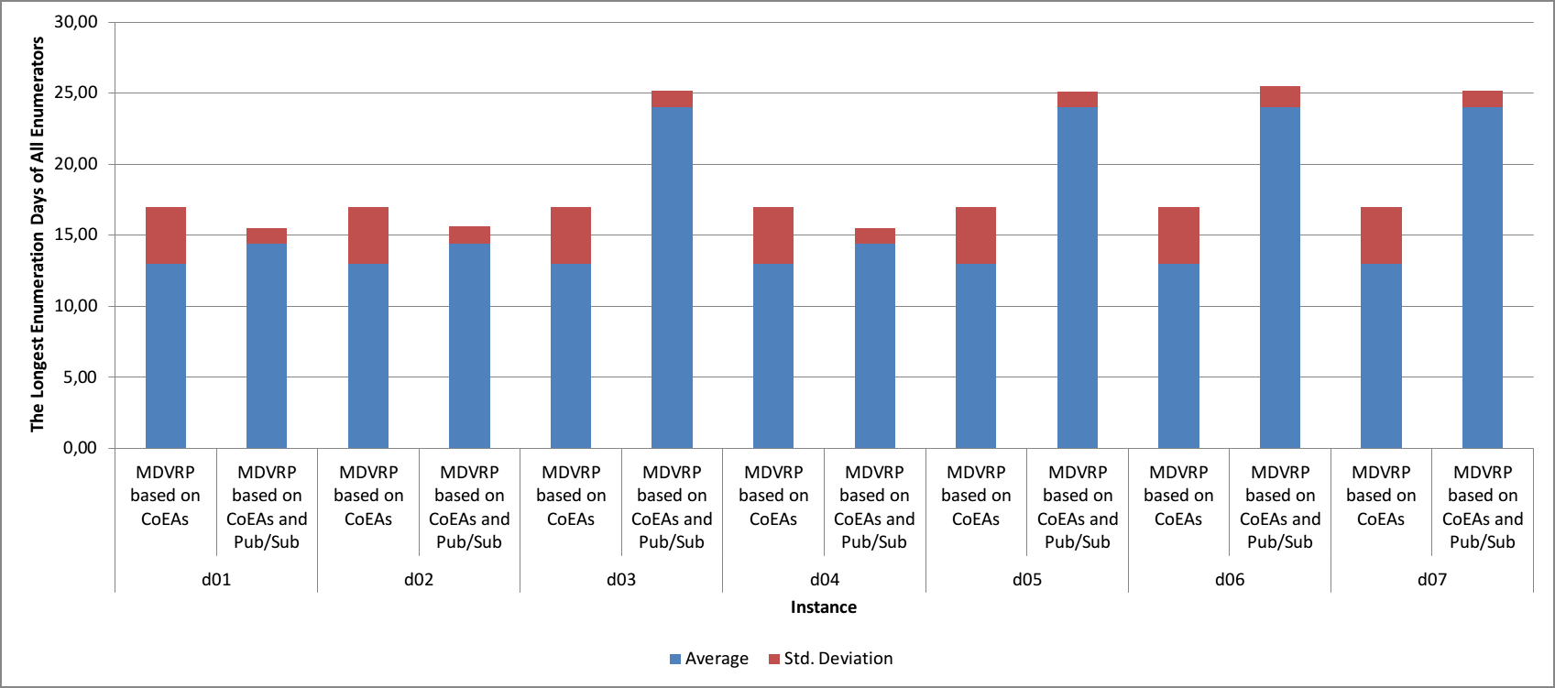

Slide 17
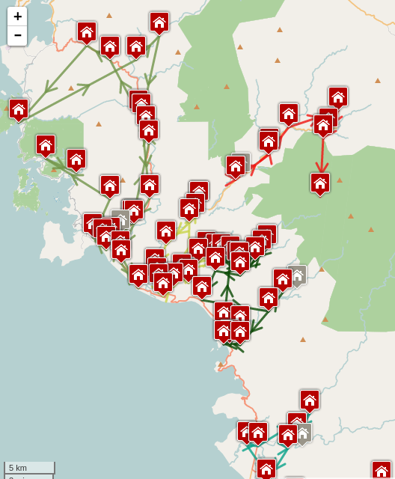

Slide 18


